Slide 1
EXPLORATORY SEARCH FOR RETRIEVING UNAWARE FIELDS FOR USERS USING ONTOLOGY CLUSTERING
PROJECT TEAM MEMBERS:
M.CHELLAMMAI(211413205025)
S.PREETHI(211413205074)
M.SAVITHA(211413205092)
PROJECT GUIDE:
R.MANJULA, M.E., (Ph.D)
Associate Professor of IT department

Slide 2
ABSTRACT
As deep web grows at a very fast pace, there has been increased interest in techniques that help efficiently locate deep-web interfaces. An exploratory search may be driven by a user’s curiosity or desire for specific information.
When users investigate unfamiliar fields, they may want to learn more about a particular subject area to increase their knowledge rather than solve a specific problem.. a matching query style has significant limitations.
Search results are satisfactory only when users give the right search words. To achieve more accurate results for a Exploratory search, Smart Crawler ranks websites to prioritize highly relevant ones for a given topic.

Slide 3
This will be achieved by using query which is submitted to the application will be preprocessed, after pre-processing only root words will be taken and it will find Synonym, Hypernym and Hyponym and it will listed to the user so this is the reason that all possible links can be found related to search.
If any words in that displayed list are selected then all the website links, images and news feeds will be given as final output to the user.
Then the book mark concept is included that is the book marked link will be added to the application directly not to the browser so the bookmarked content will visible globally.

Slide 4
LITERATURE SURVEY
S.NO | NAME OF THE PAPER WITH YEAR | OBJECTIVE | PROS | CONS
1 | AN INDEXING NETWORK MODEL FOR INFORMATION SERVICES AND ITS APPLICATIONS IN 2013. | This paper introduces an indexing network model and five related normal forms to advance the field. As a basic model, indexing network organizes and manages various information service resources through analyzing the relationships among them. | Along with the enormous amount of information service resources on the Internet, it is increasingly necessary to consider the urgent problems it has brought, such as diversity, heterogeneity, disorder, and redundancy. | Therefore, to achieve better organization and management of service resources, thereby providing more valuable information services for Internet users.
2 | GRAPH-BASED METHODS FOR NATURAL LANGUAGE PROCESSING AND UNDERSTANDING—A SURVEY AND ANALYSIS IN 2014. | This survey and analysis presents the functional components, performance, and maturity of graph-based methods for natural language processing and natural language understanding and their potential for mature products. | This paper presents a summary of such graph-based methods that are found in recent technical publications plus an analysis of their component functions and their maturity calculated from information found in the referenced papers. | Estimated scores for accuracy, coverage, scalability, and performance are derived from each method.

Slide 5
3 | EFFICIENT PHRASE-BASED DOCUMENT SIMILARITY FOR CLUSTERING IN 2008. | In this paper, we propose a phrase-based document similarity to compute the pair wise similarities of documents based on the Suffix Tree Document (STD) model. | This conclusion sufficiently explains why the phrase-based document similarity works much better than the single-word tf-idf similarity measure. | The quality of the clustering results significantly surpasses the results of traditional single-word tf-idf similarity measure in the same HAC algorithm, especially in large document data sets.
4 | INTERACTIVE QUERY EXPANSION WITH THE USE OF CLUSTERING-BY-DIRECTIONS ALGORITHM IN 2011. | This paper concerns clustering-by-directions algorithm. The algorithm introduces a novel approach to interactive query expansion. It is designed to support users of search engines in forming Web search queries. | This paper focuses on a novel approach to facilitating users in forming queries. The approach is based on clustering-bydirections (CBD) algorithm which was introduced by the author in. | This paper describes the algorithm, and it presents an enhancement which reduces the computational complexity of the algorithm. Moreover, in this paper, a new type of interface is introduced.
5 | XML KEYWORD SEARCH WITH PROMISING RESULT TYPE RECOMMENDATIONS IN 2013 | Keyword search enables inexperienced users to easily search XML database with no specific knowledge of complex structured query languages and XML data schemas | In this paper, we propose a new keyword search approach which basically utilizes the statistics of underlying XML data to decide the promising result types and then quickly retrieves the corresponding results with the help of selected promising result types | Two new algorithms proposed in this paper is somewhat complex and so not feasible enough for all kind of users

Slide 6
6 | RANKING USER AUTHORITY WITH RELEVANT KNOWLEDGE CATEGORIES FOR EXPERT FINDING | In this paper, we propose an expert finding framework based on the authority information in the target category as well as the relevant categories for ranking user authority | We develop a scalable method for measuring the relevancies between categories through topic models, which takes consideration of both content and user interaction based category similarities | Only if it is used properly with base knowledge we can attain those results correctly.
7 | WEB DOCUMENT CLUSTERING AND RANKING USING TF-IDF BASED APRIORI APPROACH IN 2014 | We proposed a new mechanism called Tf-Idf based Apriori for clustering the web documents. We then rank the documents in each cluster using Tf-Idf and similarity factor of documents based on the user query. | This approach will helps the user to get all his relevant documents in one place and can restrict his search to some top documents of his choice. | But it is not helpful if exact keywords are not known.
8 | EXPLOITING LINKED OPEN DATA AS BACKGROUND KNOWLEDGE IN DATA MINING IN 2013 | This paper discusses a framework of adding background knowledge from Linked Open Data to a given data mining problem in a fully automatic, unsupervised manner. | It introduces the FeGeLOD framework and its latest implementation, the RapidMiner Linked Open Data extension.So it is suitable for current systems | But it is time consuming and needs time to learn new approach

Slide 7
9 | INTERPRETING TF-IDF TERM WEIGHTS AS MAKING RELEVANCE DECISIONS IN 2008 | A novel probabilistic retrieval model is presented. It forms a basis to interpret the TF-IDF term weights as making relevance decisions | The signiﬁcance of interpreting TF-IDF in this way is the potential to: (1) establish a unifying perspective about information retrieval as relevance decision-making; and (2) develop advanced TF-IDF-related term weights for future elaborate retrieval models. | But this approach is not suitable for exploratory search.
10 | REPRESENTATION AND EXCHANGE OF KNOWLEDGE ABOUT ACTIONS, OBJECTS, AND ENVIRONMENTS IN THE ROBOEARTH FRAMEWORK IN 2012 | In this paper, we report on the formal language we developed for encoding this information and present our approaches to solve the inference problems related to finding information, to determining if information is usable by a robot, and to grounding it on the robot platform. | This paper presents an enhanced version of this algorithm. The enhancements include an improved version of the interface and modifications in the algorithm, which reduce its computational complexity. | The community-based generation of content has been tremendously successful in the World-Wide Web—people help each other by providing information that could be useful to others.

Slide 8
EXISTING SYSTEM
Smart Crawler performs site-based searching for center pages with the help of search engines, avoiding visiting a large number of pages.
A matching query style is unsuitable to investigate information in unfamiliar fields and to learn new associations and knowledge with relevance to a query.
When users cannot specify accurate search words, the search results are often useless. Furthermore, as information becomes more ubiquitous and demands for various searches grow, there is an increasing need to support search behaviours beyond simple lookup.

Slide 9
In the second stage, Smart Crawler achieves fast in-site searching by excavating most relevant links with an adaptive link-ranking.
To eliminate bias on visiting some highly relevant links in hidden web directories, we design a link tree data structure to achieve wider coverage for a website.

Slide 10
PROPOSED SYSTEM
This project proposes a practically efficient and flexible searchable scheme which supports both multi-keyword ranked search and synonym based search.
To address multi-keyword search and result ranking, Vector Space Model (VSM) is used to build document index, that is to say, each document is expressed as a vector where each dimension value is the Term Frequency (TF) weight of its corresponding keyword.
A new vector is also generated in the query phase. The vector has the same dimension with document index and its each dimension value is the Inverse Document Frequency (IDF) weight.

Slide 11
Then cosine measure can be used to compute similarity of one document to the search query. To improve search efficiency, a tree-based index structure which is a balance binary tree is used.
The searchable index tree is constructed with the document index vectors. So the related documents can be found by traversing the tree.

Slide 12
SYSTEM REQUIREMENTS:
Software Requirements:
Operating System : Windows 8 or Higher
Languages used : Java (JSP, Servlet), HTML,
CSS,Javascript
Tools : JDK 1.7, Net Beans 7.0.1, PhpMyAdmin,
Jelastic cloud environment
Backend : MySQL
Hardware Requirements:
Processor : Pentium Dual Core 2.3 GHz
Hard Disk : 250 GB or Higher
Ram : 4 GB

Slide 13
Novelty
Jelastic cloud environment is very secured and efficient cloud storage service.In order to make our search engine more secured for users using it, we have deployed our whole project injelasticeverdata cloud and to store large amount of keywords for static purpose we are using PHPMyAdmin provided with cloud.This has made our project more secured.
Google APIs is a set of application programming interfaces (APIs) developed by Google which allow communication with Google Services and their integration to other services. Examples of these include Search, Gmail, Translate or Google Maps. Third-party apps can use these APIs to take advantage of or extend the functionality of the existing services.We are using gmail API for enquiry,login purpose and search API for dynamic purpose.
We use this API to fetch the results in dynamic part of our project

Slide 14
FEASIBLITY STUDY
Economical feasibility – Search engine organizations will get benefited as they can use our system for all kind of users.And also as we are using PAAS service jelastic cloud, we are paying only for what we have used and it is economical.
Social feasibility - all kind of users will be benefited even if they doesn’t know exact keywords they can use our system for searching as we are using kmeans,vector space and cosine similarity algorithm to get proper hyponyms , hypernyms , synonyms for the keywords.
Resource feasibility – as we are using jelastic cloud environment minimal resources is utilized.

Slide 15
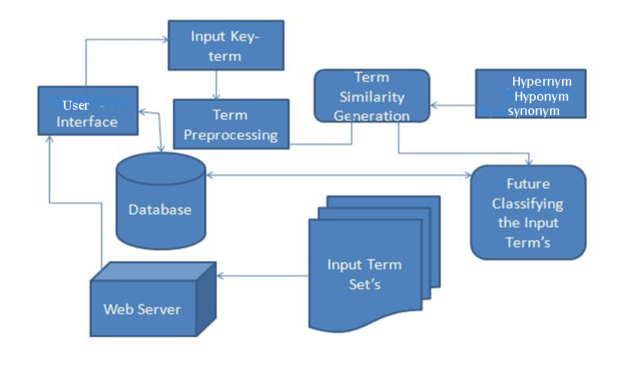

SYSTEM ARCHITECTURE

Slide 16
DATA FLOW DIGRAM:
User Interface:
Login
Verification
Searching for answers
User
DataBase

Slide 17
Data Preprocessing:
Search query
Stop Words
Read Each words
Remove Stop words
Stem to root words

Slide 18
Ontology:
Search results
Cluster result
Hypernym
Synonym
Hyponym

Slide 19
MODULES DESCRIPTION
User Interface
Search space
Input from User
Data Preprocessing
Stop word Removal
Porter Stemming
Ontology Clustering
Multi-term Search
Cluster the Most Relevant Content
Book marking

Slide 20
User Interface:
Search space
After user login process, web user can enter the search space page.
This is the environment for user to search the content from the web server.
This Search Space is the interface for user and web servers.
Input from User
Get the input text from the user for the search process.

Slide 21
Data Preprocessing:
Stop Word Removal:
Stop words are words which are filtered out prior to, or after, processing of natural language data (text). It is controlled by human input and not automated.
Porter Stemming:
Stemmers employ a lookup table which contains relations between root forms and inflected forms. To stem a word, the table is queried to find a matching inflection. If a matching inflection is found, the associated root form is returned. Eg: A stemming algorithm reduces the words "fishing", "fished", "fish", and "fisher" to the root word, "fish".

Slide 22
Ontology Clustering:
Words ending in nym’s are often used to describe different classes of words, and the relationships between words.
Hypernym: A word that has a more general meaning than another.
A hypernym is a word that is used for many things. As an example, the word "color" is a hypernym for red, green, blue, brown, etc. Or the term "vehicle" is a hypernym of car, plane, train, bike,etc. Red, green, and blue are all hyponyms of the hypernym "color". Crimson, rose, cherry, and scarlet can all be hyponyms of the word "red", in which case "red" would be a hypernym for those words.

Slide 23
Multi-term Search:
The term "multiple meaning words" is loosely applied to written words that can have more than one use or definition, and the intended use must be conveyed by the context, the other words in the sentence or paragraph.
Homographs are words that are written the same, but have different meanings and word forms, and may have different pronunciations.
This is common where words such as "dance" or "cut" share the same spelling for their noun and verb forms. Example : lead (the metal) and lead (the verb for going ahead). Without the sound difference, it may need to be clarified.

Slide 24
Cluster the Most Relevant Content:
Clustering sentences by keywords. SIMBA produces a generic summary. Thus, the keywords that represent the global topic within the collection of texts are identified.
The candidate keywords list contains common and proper names. It is built considering the lemma of the words, to ensure that the words in the collection are unique. There-after, the list is ordered considering the score of each word. in the clusters that represent the first set of keywords.
These sentences are considered more significant than the others, since they address the main topics conveyed by the collection of texts.

Slide 25
Book marking:
Local and global book marking can be done for the page user using and it is very helpful as it is not browser dependent and book marks are stored in database.
This can overcome the drawback in real browsers since in real browsers we can only book mark in one particular browser and if we need that in another browser we need to import the book marks. Instead of that we can save book marks in database or user’s folders.

Slide 26
START
PROJECT WORKFLOW:
STOP
DATABASE
LOGIN
BOOKMARK
invalid
CHECK IF IT’S VALID?
WEBSITES
valid
QUERY TO SEARCH
Hypernym
Database
Read Each words
Cluster result
Hyponym
Synonym
Remove Stop words
Stem to root words

Slide 27
K-means clustering algorithm
k-means is one of the simplest unsupervised learning algorithms that solve the well known clustering problem. The procedure follows a simple and easy way to classify a given data set through a certain number of clusters (assume k clusters) fixed apriori.
The main idea is to define k centers, one for each cluster. These centers should be placed in a cunning way because of different location causes different result. So, the better choice is to place them as much as possible far away from each other.
The next step is to take each point belonging to a given data set and associate it to the nearest center. When no point is pending, the first step is completed and an early group age is done. At this point we need to re-calculate k new centroids as barycenter of the clusters resulting from the previous step.
After we have these k new centroids, a new binding has to be done between the same data set points and the nearest new center. A loop has been generated. As a result of this loop we may notice that the k centers change their location step by step until no more changes are done or in other words centers do not move any more.

Slide 28

Finally, this algorithm aims at minimizing an objective function know as squared error function given by:
where, ‘||x_{i} - v_{j}||’ is the Euclidean distance
between x_{i} and v_{j.}
‘c_{i}’ is the number of data points in i^{th} cluster.
‘c’ is the number of cluster centers.

Slide 29

Algorithmic steps for k-means clustering
Let X = {x₁,x₂,x₃,……..,x_{n}} be the set of data points and V = {v₁,v₂,…….,v_{c}} be the set of centers.
1) Randomly select ‘c’ cluster centers.
2) Calculate the distance between each data point and cluster centers.
3) Assign the data point to the cluster center whose distance from the cluster center is minimum of all the cluster centers..
4) Recalculate the new cluster center using:
where, ‘c_{i}’ represents the number of data points in i^{th} cluster.
5) Recalculate the distance between each data point and new obtained cluster centers.
6) If no data point was reassigned then stop, otherwise repeat from step 3).

Slide 30
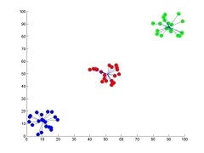
Advantages
1) Fast, robust and easier to understand.
2) Relatively efficient: O(tknd), where n is # objects, k is # clusters, d is # dimension of each object, and t is # iterations. Normally, k, t, d << n.
3) Gives best result when data set are distinct or well separated from each other.
Fig: Showing the result of k-means for 'N' = 60 and 'c' = 3

Slide 31
VECTOR SPACE MODEL:
Vector space model or term vector model is an algebraic model for representing text documents as vectors of identifiers, such as, for example, index terms.
It is used in information filtering, information retrieval, indexing and relevancy rankings. Its first use was in the SMART Information Retrieval System.
Definitions
Documents and queries are represented as vectors.
Each dimension corresponds to a separate term. If a term occurs in the document, its value in the vector is non-zero. Several different ways of computing these values, also known as (term) weights, have been developed. One of the best known schemes is tf-idf weighting.
Terms are single words, keywords, or longer phrases.
Vector operations can be used to compare documents with queries.

Slide 32
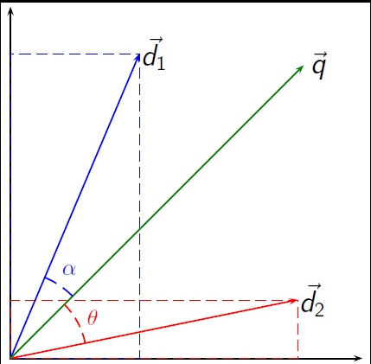

Slide 33


tf-idf weights
In the classic vector space model proposed by Salton, Wong and Yang the term-specific weights in the document vectors are products of local and global parameters. The model is known as term frequency-inverse document frequency model. The weight vector for document d:
Where,
and
is term frequency of term t in document d (a local parameter)

Slide 34



is inverse document frequency (a global parameter).
is the total number of documents in the document set;
is the number of documents containing the term t.
Using the cosine the similarity between document d_{j} and query q can be calculated as:

Slide 35
ALGORITHM:
SUCCESSOR VARIETY STEMMING
Successor variety stemmers (Hafer and Weiss 1974) are based on work in structural linguistics which attempted to determine word and morpheme boundaries based on the distribution of phonemes in a large body of utterances. The stemming method based on this work uses letters in place of phonemes, and a body of text in place of phonemically transcribed utterances.
Hafer and Weiss formally defined the technique as follows:
Let be a word of length n; α _{i}, is a length i prefix of α . Let D be the corpus of words. Dαi is defined as the subset of D containing those terms whose first i letters match exactly.

Slide 36
The successor variety of i, denoted Sαi, is then defined as the number of distinct letters that occupy the i + 1st position of words in Dαi. A test word of length n has n successor varieties Sαi_{, S 2}, . . . , _{S n.}
In less formal terms, the successor variety of a string is the number of different characters that follow it in words in some body of text. Consider a body of text consisting of the following words, for example
able, axle, accident, ape, about.
To determine the successor varieties for "apple," for example, the following process would be used. The first letter of apple is "a." "a" is followed in the text body by four characters: "b," "x," "c," and "p." Thus, the successor variety of "a" is four. The next successor variety for apple would be one, since only "e" follows "ap" in the text body, and so on.
When this process is carried out using a large body of text (Hafer and Weiss report 2,000 terms to be a stable number), the successor variety of substrings of a term will decrease as more characters are added until a segment boundary is reached. At this point, the successor variety will sharply increase. This information is used to identify stems.

Slide 37


Once the successor varieties for a given word have been derived, this information must be used to segment the word. Hafer and Weiss discuss four ways of doing this.
1. Using the cutoff method, some cutoff value is selected for successor varieties and a boundary is identified whenever the cutoff value is reached. The problem with this method is how to select the cutoff value--if it is too small, incorrect cuts will be made; if too large, correct cuts will be missed.
2. With the peak and plateau method, a segment break is made after a character whose successor variety exceeds that of the character immediately preceding it and the character immediately following it. This method removes the need for the cutoff value to be selected.
3. In the complete word method method, a break is made after a segment if the segment is a complete word in the corpus.
4. The entropy method takes advantage of the distribution of successor variety letters. The method works as follows. Let |Dαi| be the number of words in a text body beginning with the i length sequence of letters . Let |Dαij| be the number of words in Dαi with the successor j. The probability that a member of Dαi has the successor j is given by .
_{The entropy of |Dαi| is}

Slide 38
Using this equation, a set of entropy measures can be determined for a word. A set of entropy measures for predecessors can also be defined similarly. A cutoff value is selected, and a boundary is identified whenever the cutoff value is reached.
Hafer and Weiss experimentally evaluated the various segmentation methods using two criteria: (1) the number of correct segment cuts divided by the total number of cuts, and (2) the number of correct segment cuts divided by the total number of true boundaries. They found that none of the methods performed perfectly, but that techniques that combined certain of the methods did best.

Slide 39
To illustrate the use of successor variety stemming, consider the example below where the task is to determine the stem of the word READABLE.
Test Word: READABLE
Corpus: ABLE, APE, BEATABLE, FIXABLE, READ, READABLE
READING, READS, RED, ROPE, RIPE.
Prefix Successor Variety Letters
-----------------------------------------------
R 3 E,I,O
RE 2 A,D
REA 1 D
READ 3 A,I,S
READA 1 B
READAB 1 L
READABL 1 E
READABLE 1 BLANK
Using the complete word segmentation method, the test word "READABLE" will be segmented into "READ" and "ABLE," since READ appears as a word in the corpus. The peak and plateau method would give the same result.
After a word has been segmented, the segment to be used as the stem must be selected. Hafer and Weiss used the following rule:
if (first segment occurs in <= 12 words in corpus)
first segment is stem
else (second segment is stem)

Slide 40
The check on the number of occurrences is based on the observation that if a segment occurs in more than 12 words in the corpus, it is probably a prefix. The authors report that because of the infrequency of multiple prefixes in English, no segment beyond the second is ever selected as the stem. Using this rule in the example above, READ would be selected as the stem of READABLE.
In summary, the successor variety stemming process has three parts:
(1) determine the successor varieties for a word,
(2) use this information to segment the word using one of the methods above, and
(3) select one of the segments as the stem. The aim of Hafer and Weiss was to develop a stemmer that required little or no human processing. They point out that while affix removal stemmers work well, they require human preparation of suffix lists and removal rules.
Their stemmer requires no such preparation.

Slide 41
STOP WORD LIST:
If you want to use stop words lists that have been published here are a few that you could use: Snowball stop word list – this stop word list is published with the Snowball Stemmer
Terrier stop word list – this is a pretty comprehensive stop word list published with the Terrier package.
Minimal stop word list – this is a stop word list that I compiled consisting of determiners, coordinating conjunctions and prepositions
Construct your own stop word list – this article basically outlines an automatic method for constructing a stop word list for your specific data set (e.g. tweets, clinical texts, etc)

Slide 42
CODING:
Login.java
import java.io.IOException;
import java.io.PrintWriter;
import java.sql.*;
import javax.servlet.RequestDispatcher;
import javax.servlet.ServletException;
import javax.servlet.http.HttpServlet;
import javax.servlet.http.HttpServletRequest;
import javax.servlet.http.HttpServletResponse;
public class Login extends HttpServlet {
protected void processRequest(HttpServletRequest request, HttpServletResponse response)
throws ServletException, IOException {
response.setContentType("text/html;charset=UTF-8");
PrintWriter out = response.getWriter();
try {
String user=request.getParameter("user").trim();
String pass=request.getParameter("pass").trim();

Slide 43
Class.forName("com.mysql.jdbc.Driver");
Connection con=DriverManager.getConnection("jdbc:mysql://localhost:3306/deepsearch","root","root");
Statement st=con.createStatement();
ResultSet rs=st.executeQuery("select * from user");
while(rs.next())
{
String us=rs.getString("mailid").trim();
String ps=rs.getString("password").trim();
if(user.equals(us) && pass.equals(ps))
{
System.out.println("Success");
response.sendRedirect("1search.jsp");
}
else
{
response.sendRedirect("login.jsp");
}

Slide 44
}
}
catch(Exception e)
{
System.out.println(e);
} finally {
out.close();
}
}
Preprocess.java
import java.io.FileOutputStream;
import java.io.IOException;
import java.io.PrintStream;
import java.io.PrintWriter;
import javax.servlet.ServletException;
import javax.servlet.http.HttpServlet;
import javax.servlet.http.HttpServletRequest;
import javax.servlet.http.HttpServletResponse;
import javax.servlet.http.HttpSession;

Slide 45
public class Preprocess extends HttpServlet {
protected void processRequest(HttpServletRequest request, HttpServletResponse response)
throws ServletException, IOException {
response.setContentType("text/html;charset=UTF-8");
PrintWriter out = response.getWriter();
HttpSession session=request.getSession(true);
try {
String key=request.getParameter("key");
session.setAttribute("Rinp", key);
String ppkey="";
String keya[]=key.split(" ");
for(int i=0;i<keya.length;i++)
{
String swr=keya[i];
if(!swr.equalsIgnoreCase("how") && !swr.equalsIgnoreCase("a") && !swr.equalsIgnoreCase("and")&&!swr.equalsIgnoreCase("he")&&!swr.equalsIgnoreCase("i")

Slide 46
&&!swr.equalsIgnoreCase("in")&&!swr.equalsIgnoreCase("is")&&!swr.equalsIgnoreCase("it")&&!swr.equalsIgnoreCase("of")
&&!swr.equalsIgnoreCase("that")&&!swr.equalsIgnoreCase("the")&&!swr.equalsIgnoreCase("to")&&!swr.equalsIgnoreCase("was")
&&!swr.equalsIgnoreCase("all")&&!swr.equalsIgnoreCase("are")&&!swr.equalsIgnoreCase("as")&&!swr.equalsIgnoreCase("at")
&&!swr.equalsIgnoreCase("be")&&!swr.equalsIgnoreCase("but")&&!swr.equalsIgnoreCase("for")&&!swr.equalsIgnoreCase("had")
&&!swr.equalsIgnoreCase("him")&&!swr.equalsIgnoreCase("his")&&!swr.equalsIgnoreCase("not")&&!swr.equalsIgnoreCase("on")
&&!swr.equalsIgnoreCase("one")&&!swr.equalsIgnoreCase("said")&&!swr.equalsIgnoreCase("so")&&!swr.equalsIgnoreCase("they")

Slide 47
&&!swr.equalsIgnoreCase("we")&&!swr.equalsIgnoreCase("with")&&!swr.equalsIgnoreCase("you")&&!swr.equalsIgnoreCase("adout")
&&!swr.equalsIgnoreCase("an")&&!swr.equalsIgnoreCase("back")&&!swr.equalsIgnoreCase("been")&&!swr.equalsIgnoreCase("before")
&&!swr.equalsIgnoreCase("big")&&!swr.equalsIgnoreCase("by")&&!swr.equalsIgnoreCase("call")&&!swr.equalsIgnoreCase("came")
&&!swr.equalsIgnoreCase("can")&&!swr.equalsIgnoreCase("come")&&!swr.equalsIgnoreCase("could")&&!swr.equalsIgnoreCase("did")
&&!swr.equalsIgnoreCase("do")&&!swr.equalsIgnoreCase("down")&&!swr.equalsIgnoreCase("first")&&!swr.equalsIgnoreCase("from")
&&!swr.equalsIgnoreCase("get")&&!swr.equalsIgnoreCase("go")&&!swr.equalsIgnoreCase("ad")&&!swr.equalsIgnoreCase("her")
&&!swr.equalsIgnoreCase("here")&&!swr.equalsIgnoreCase("if")&&!swr.equalsIgnoreCase("into")&&!swr.equalsIgnoreCase("just")

Slide 48
{
if(ppkey.equals(""))
{
ppkey=ppkey+swr;
}
else if(!ppkey.equals(""))
{
ppkey=ppkey+" "+swr;
}
}
}
catch(Exception e)
{
out.println(e);
}
finally {
out.close();
}
}

Slide 49
Performance measures of Proposed System
 | Query search processing | Data Preprocessing | Page Bookmarking | Result
Performance metrics | 4 | 3 | 4 | 6

Slide 50

SNAPSHOTS
HOME PAGE:

Slide 51
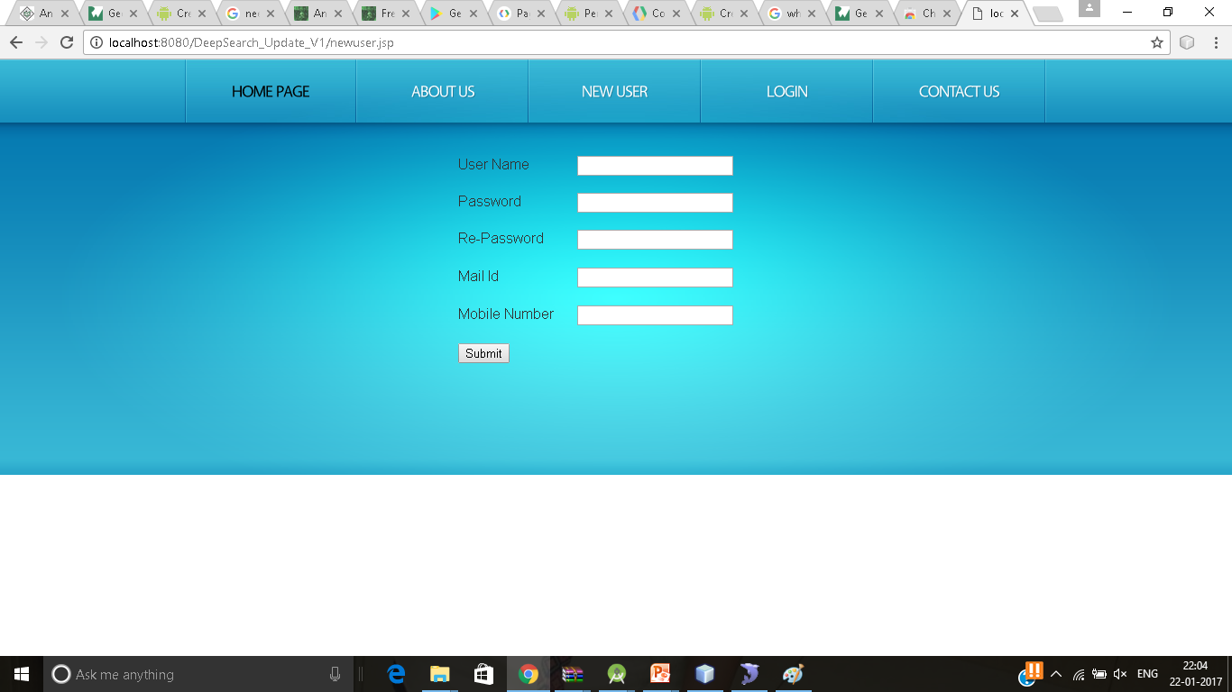
REGISTRATION:-NEW USER

Slide 52
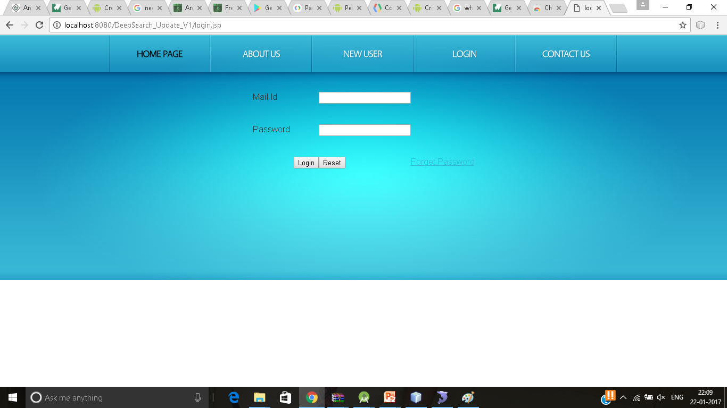
LOGIN:

Slide 53
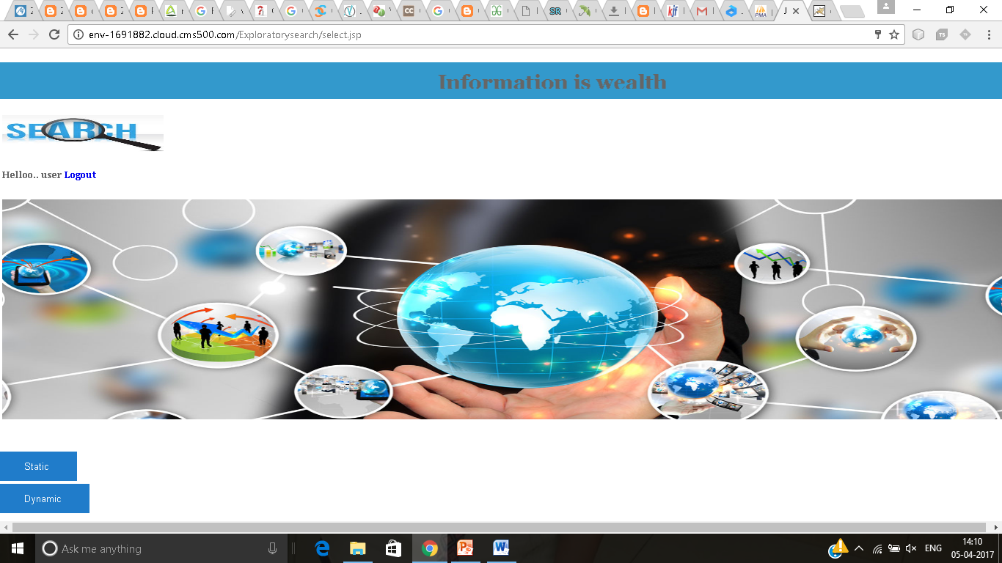
SEARCH ENGINE STATIC, DYNAMIC PAGE:

Slide 54
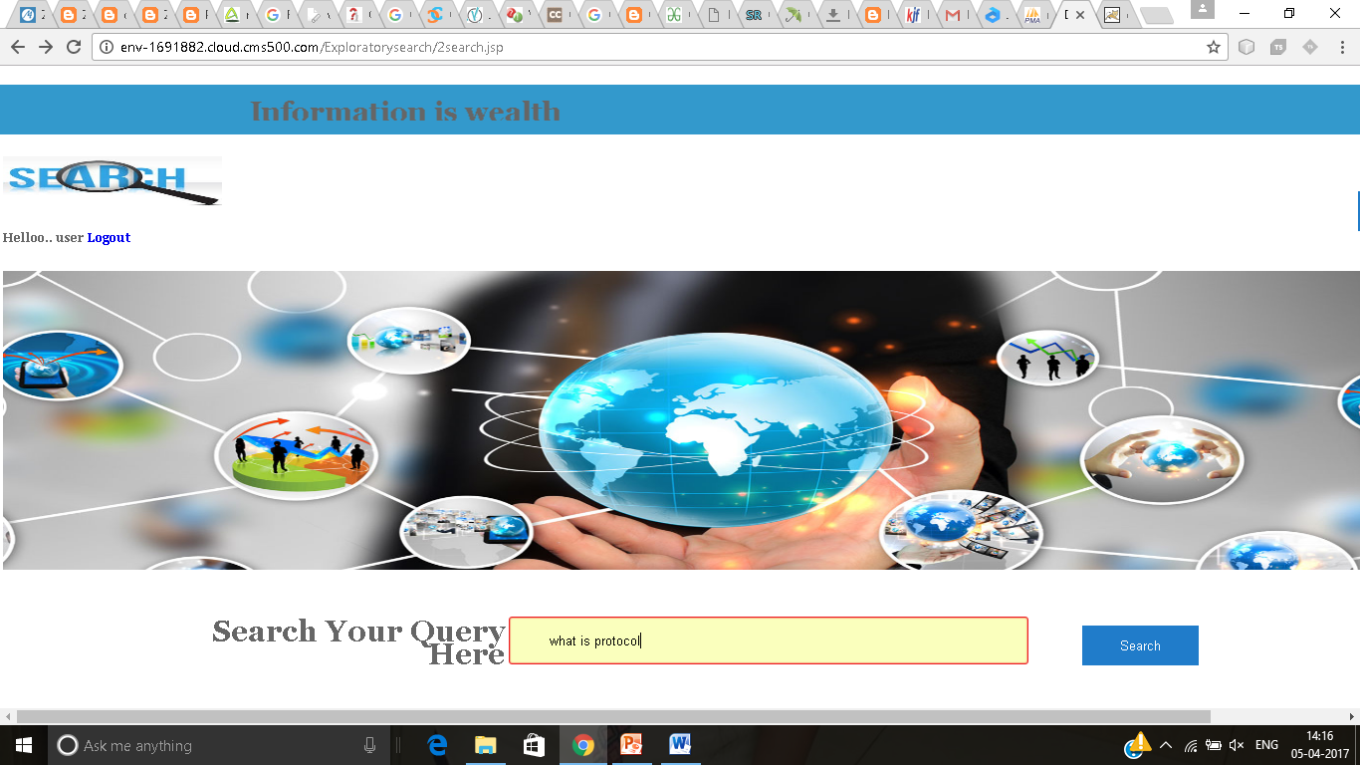
SEARCH ENGINE:

Slide 55
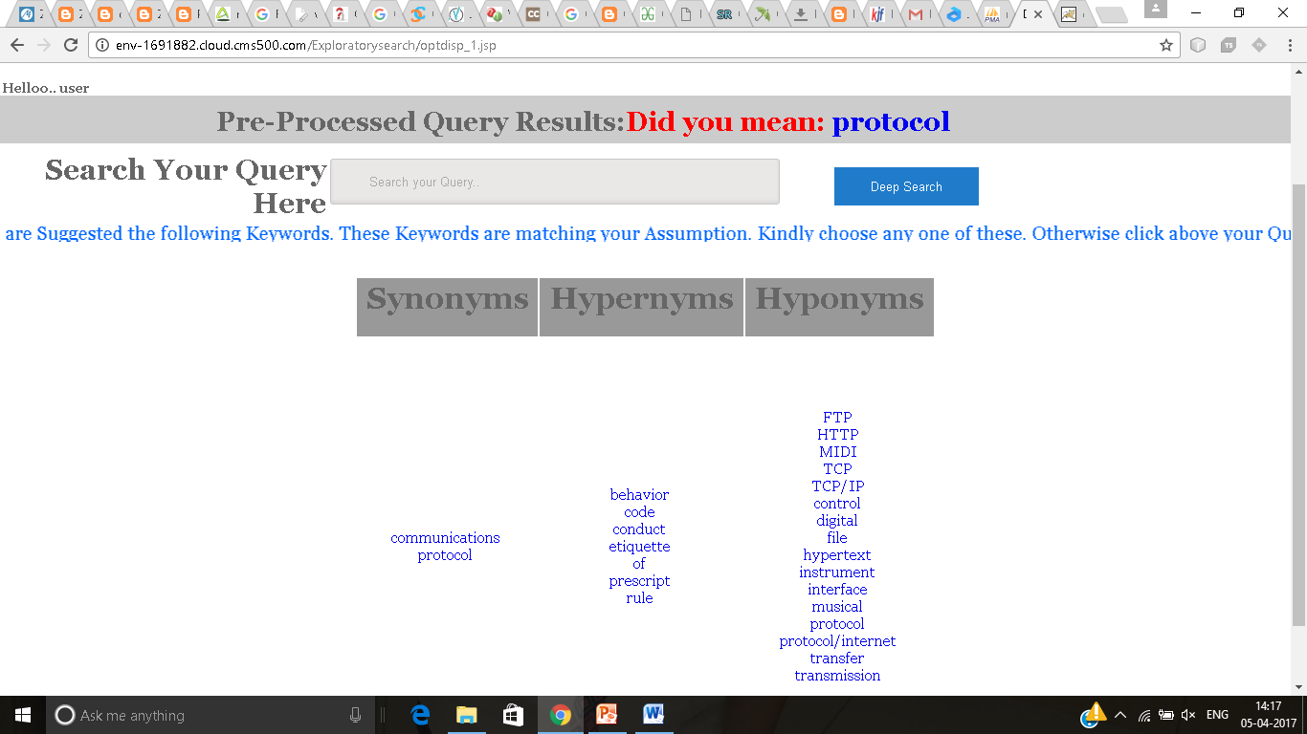
EXPLORATORY SEARCH:

Slide 56
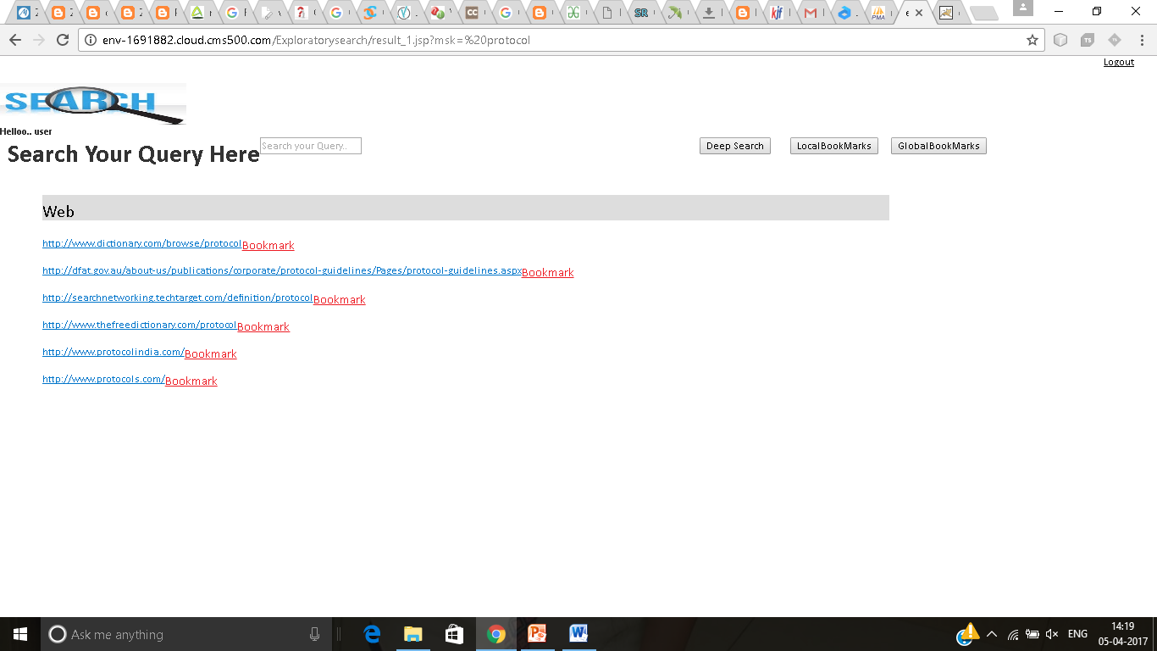
WEBSITES:

Slide 57
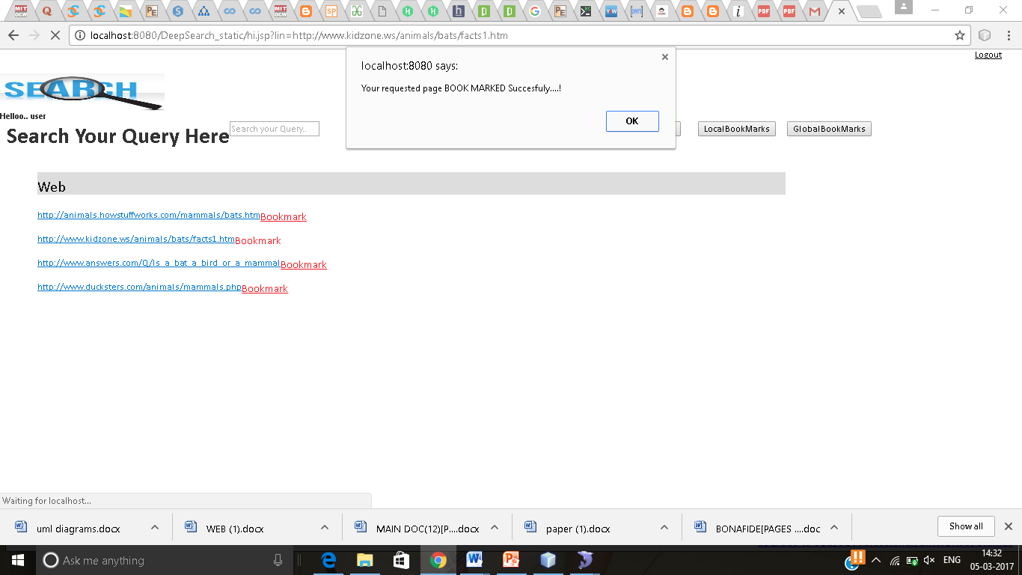
BOOKMARKING:

Slide 58
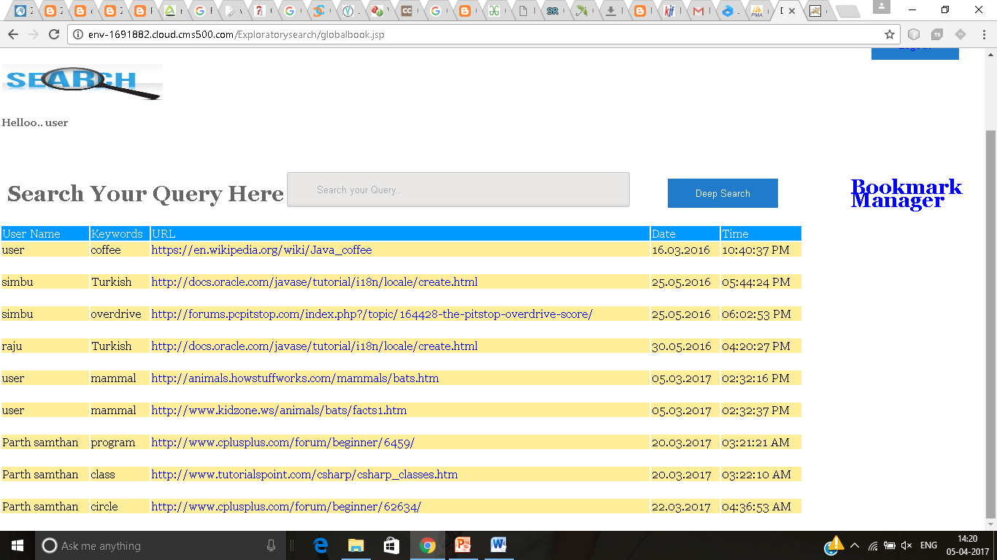
BOOKMARKING MANAGER:

Slide 59
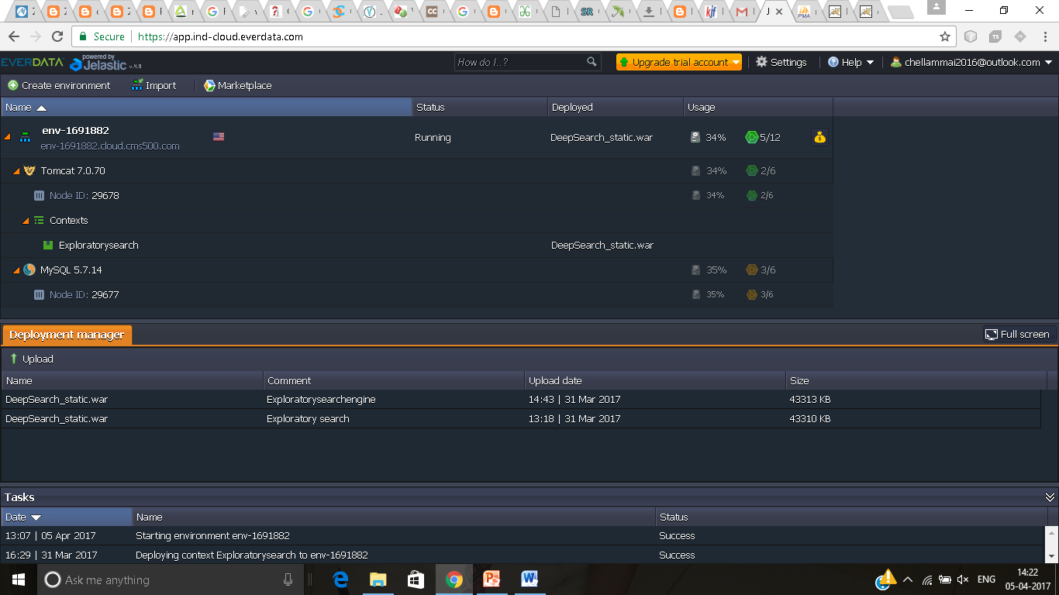
JELASTIC CLOUD ENVIRONMENT-DEPLOYMENT:

Slide 60
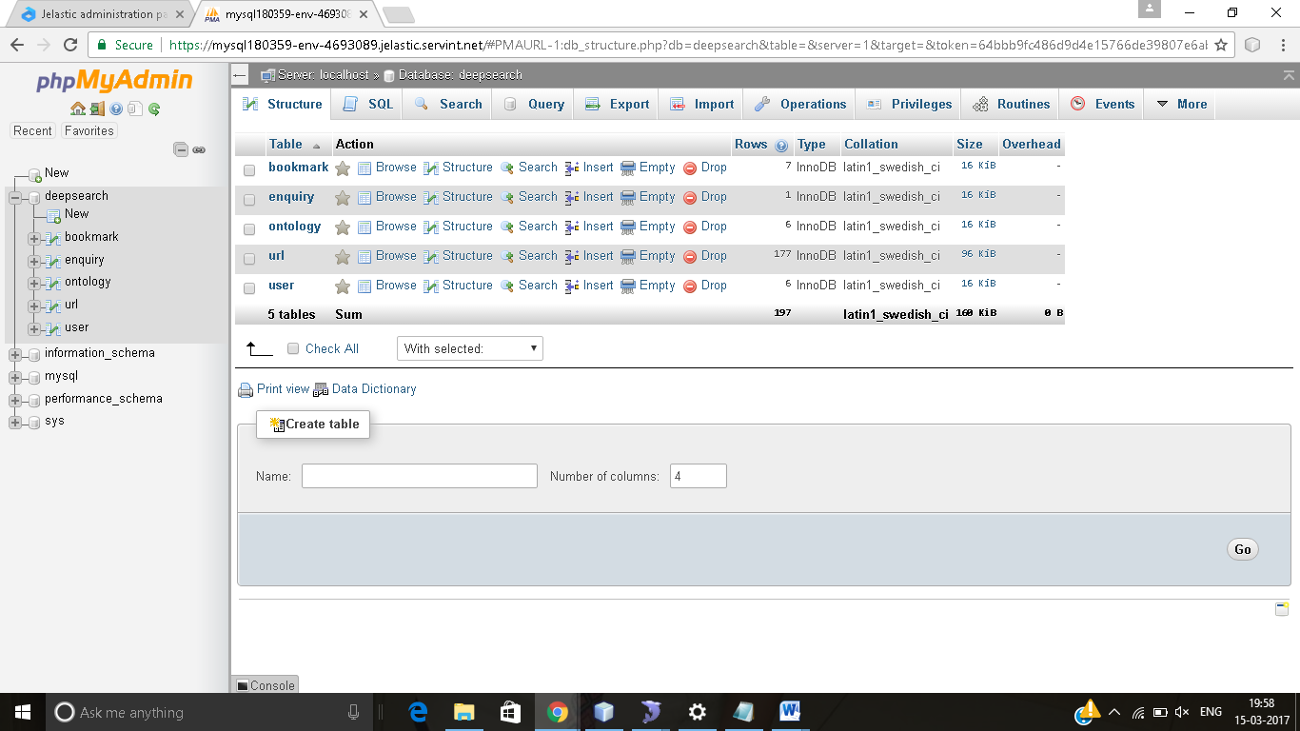
PHPMYADMIN PAGE-IN JELASTIC :

Slide 61
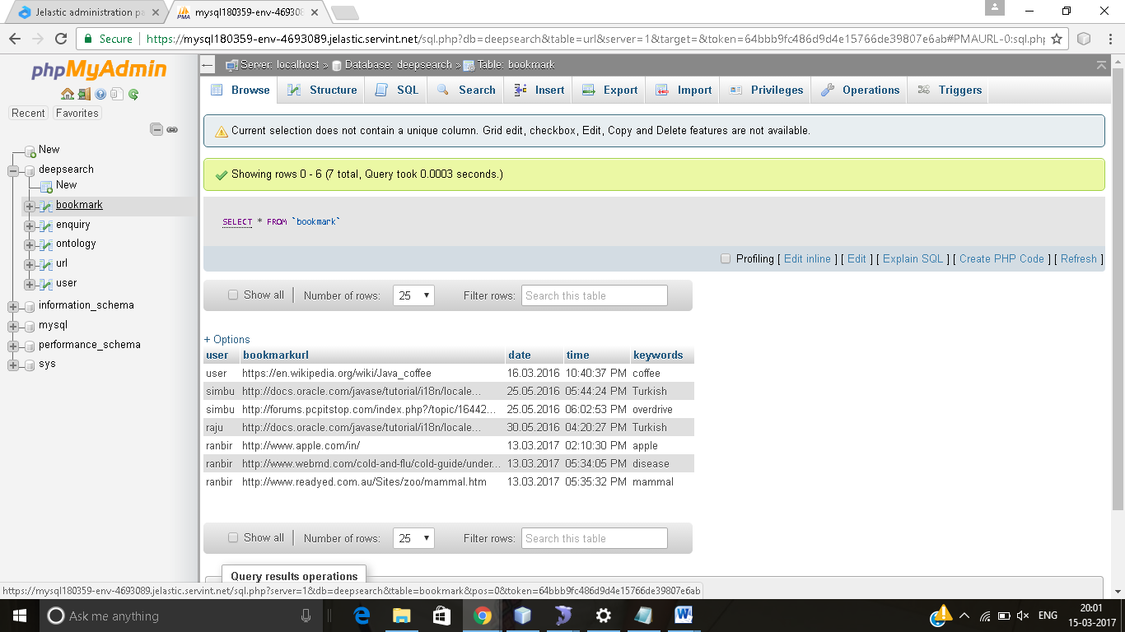
BOOKMARK DATABASE:

Slide 62
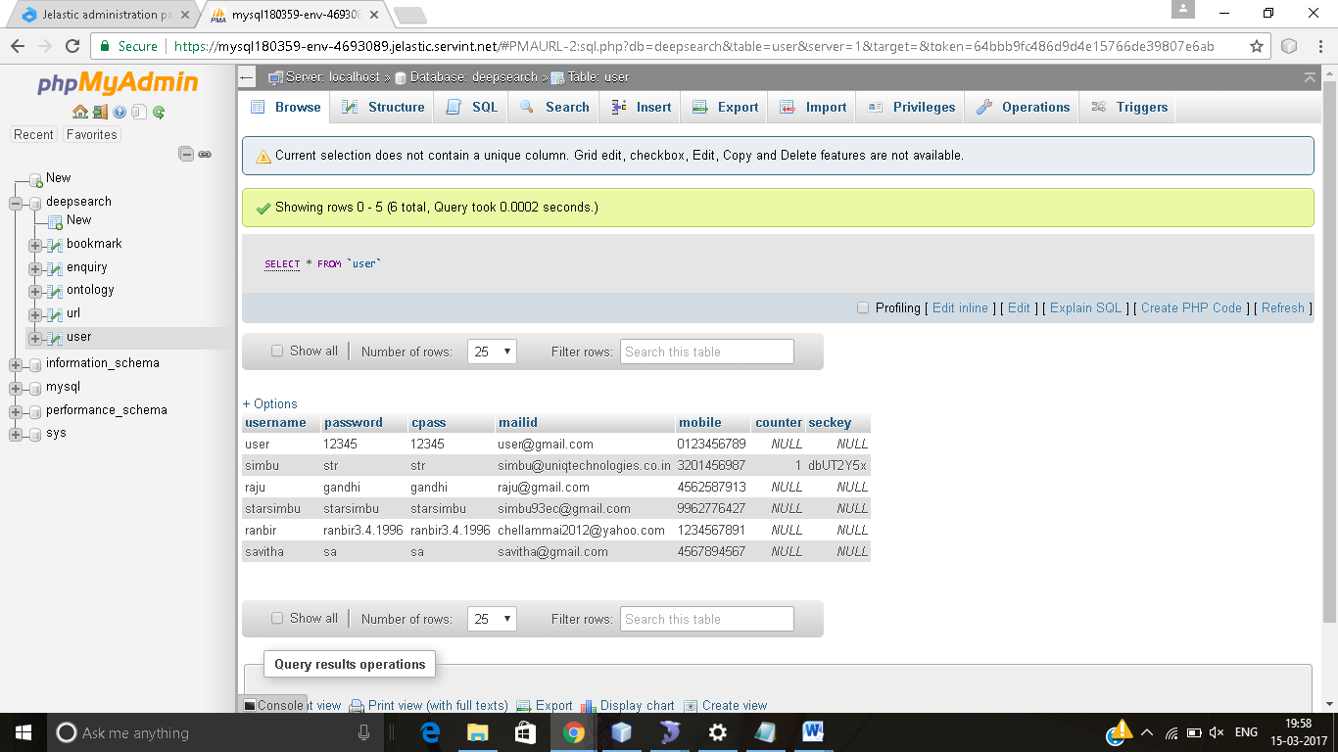
SCREENSHOT FOR USER DATABASE

Slide 63
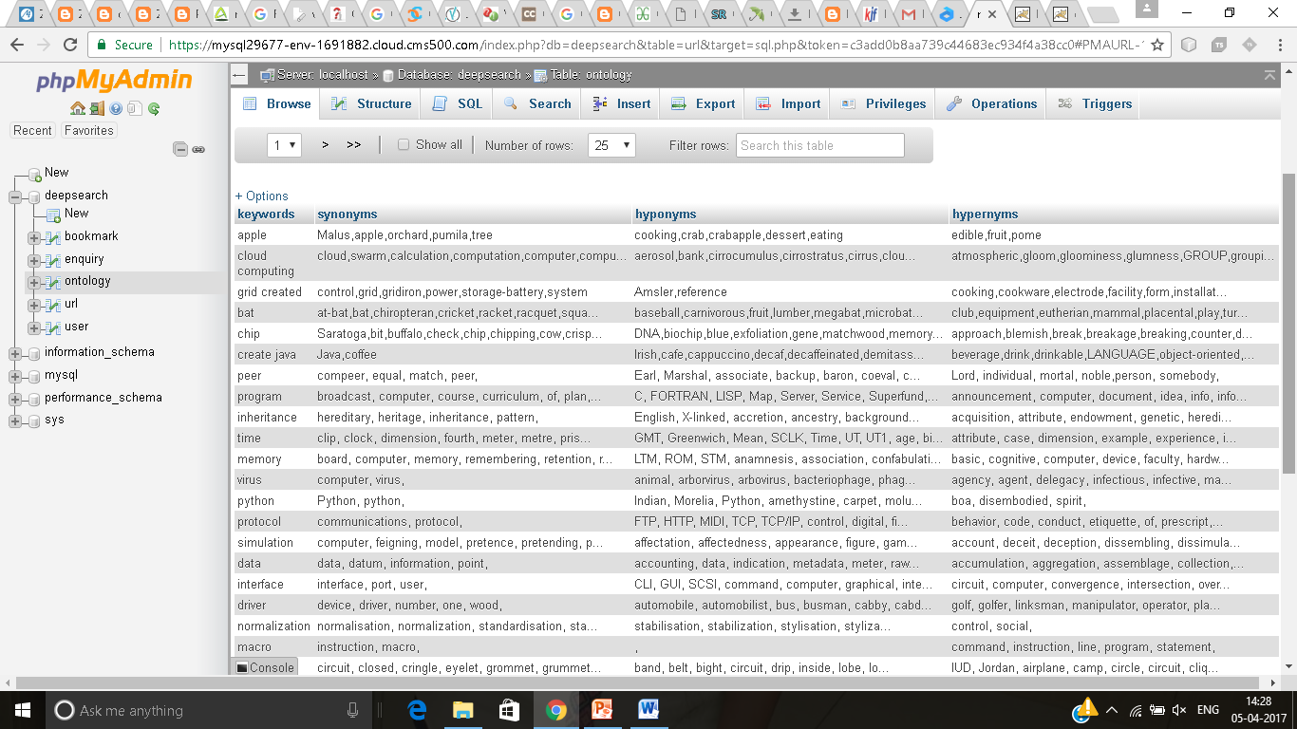
SCREENSHOT FOR KEYWORDS DATABASE

Slide 64
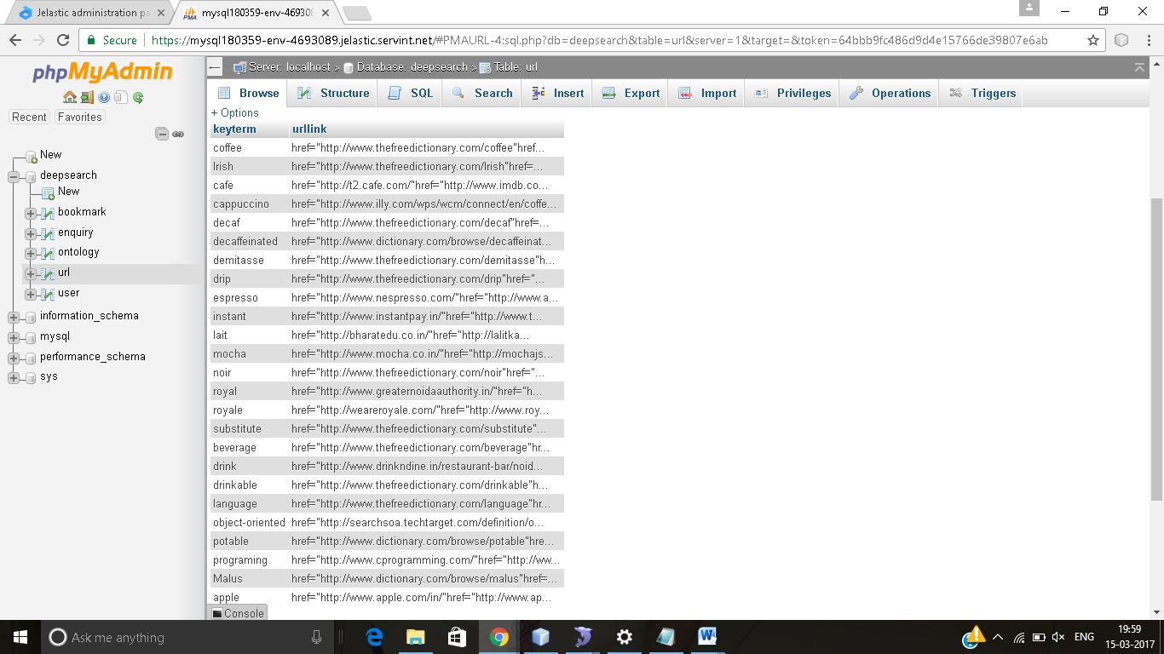
SCREENSHOT FOR URL DATABASE:

Slide 65
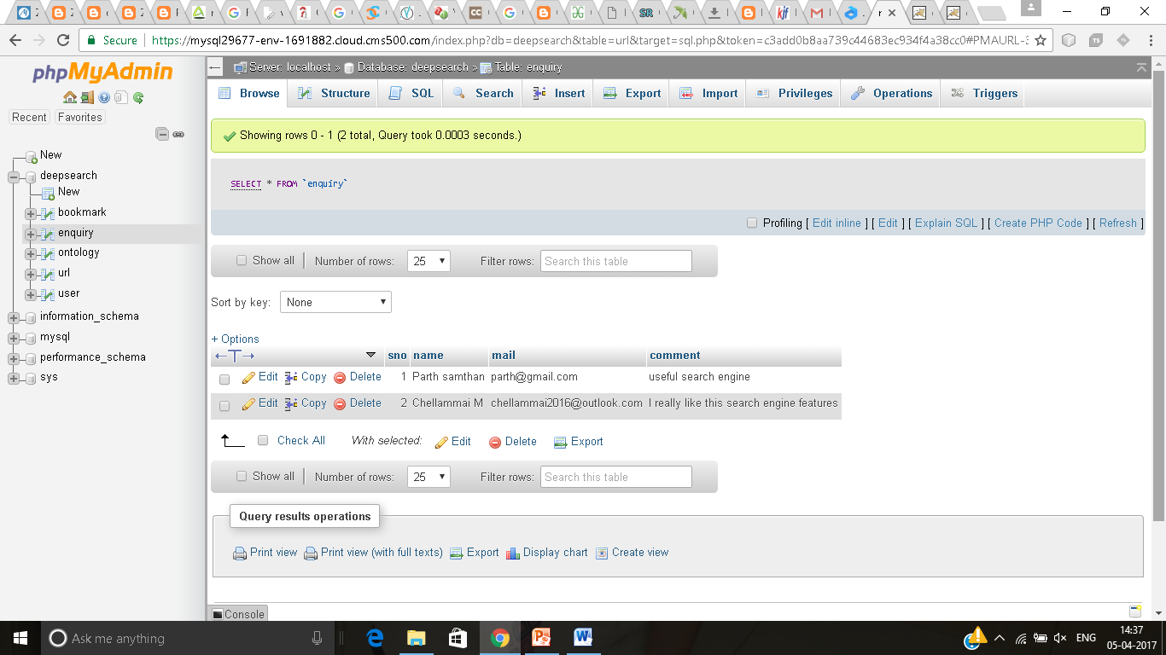
SCREENSHOT FOR ENQUIRY DATABASE:

Slide 66
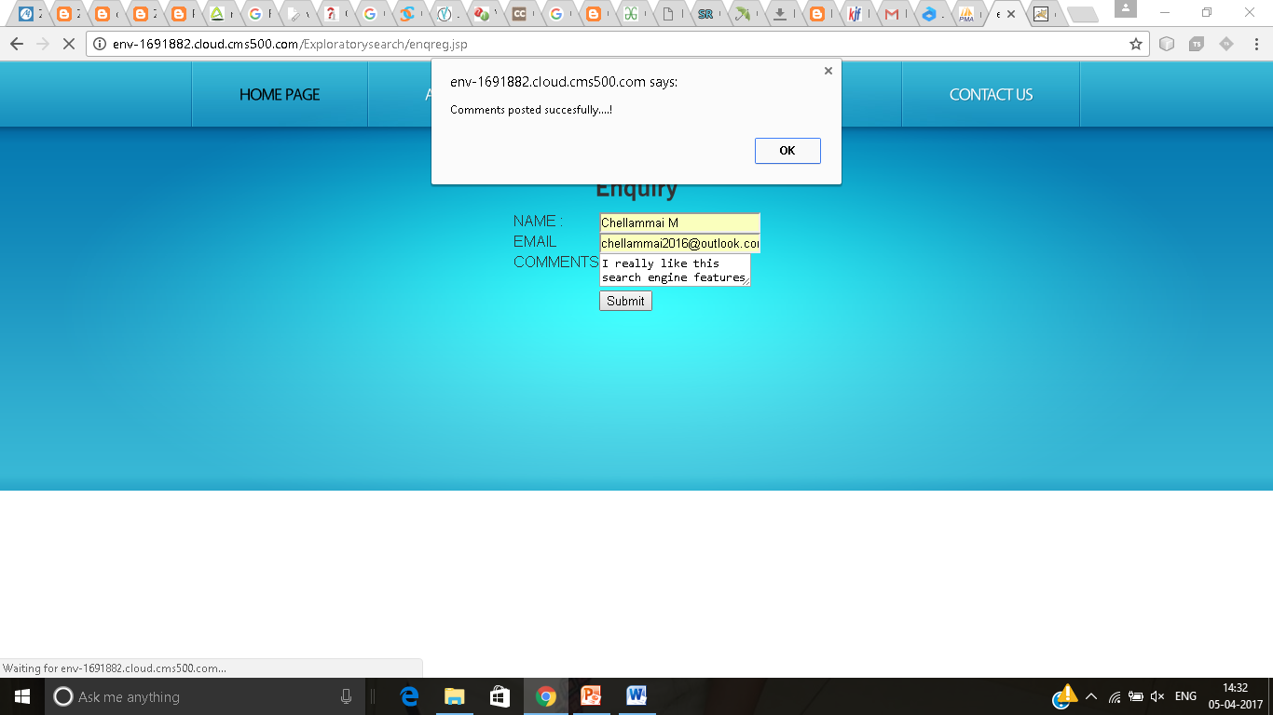
ENQUIRY:

Slide 67
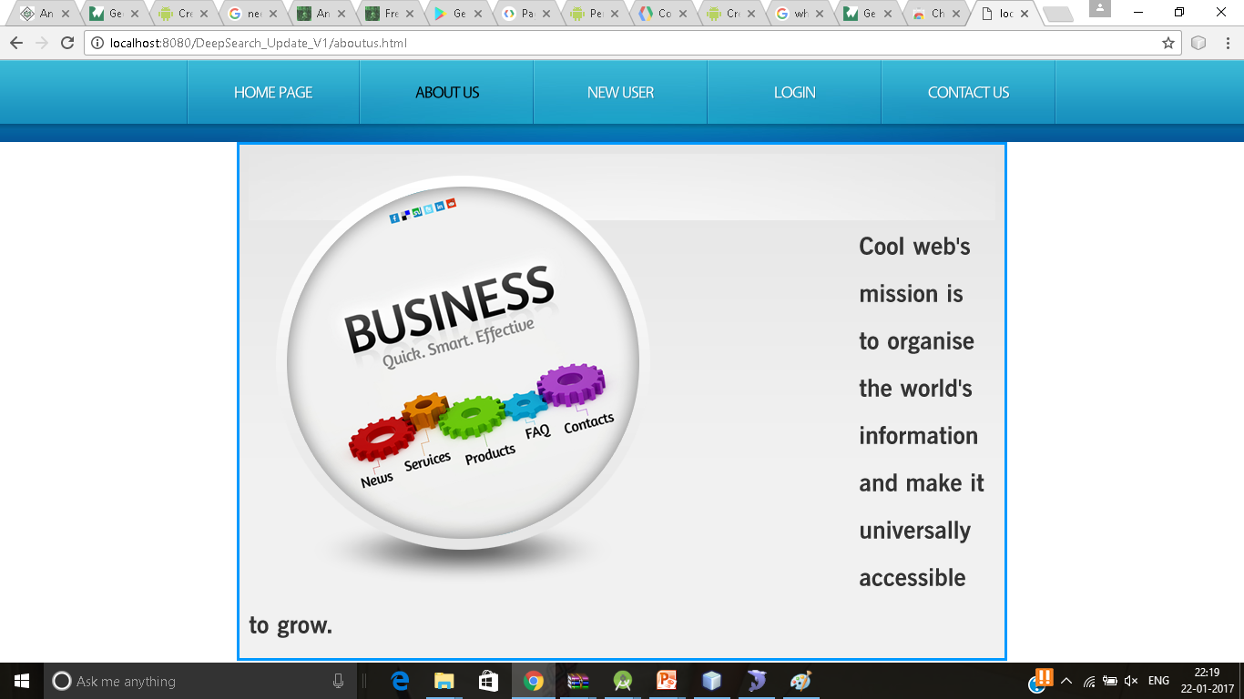
ABOUT US:

Slide 68
MODULE 1: USER INTERFACE
PROCESS: REGISTER
LOGIN
MODULE 2: DATA PREPROCESSING
USER GIVES A QUERY
PROCESS: STOPPING
STEMMING
MODULE 3: ONTOLOGY CLUSTERING
PROCESS: GIVING DIFFERENT MEANINGS OF THE
PRE-PROCESSED QUERY BASED ON
SYNONYMS - SIMILAR
HYPERNYMS – GENERAL
HYPONYMS - TECHNICAL

Slide 69
MODULE 4: MULTI TERM SEARCHING
PROCESS: SELECTING THE REQUIRED WORD
FROM THE ONTOLOGY CLUSTER
MODULE 5: CLUSTER THE MOST RELEVANT CONTENT
PROCESS: GROUPING SIMILAR WEBSITES
MODULE 6: BOOK MARKING
PROCESS: BOOK MARKING THE USEFUL SITES

Slide 70
REFERENCES
[1] C. J. Jiang et al., “An indexing network model for information servicesand its applications,” in Proc. 6th IEEE Int. Conf. Serv. Orient.Comput.Appl., Koloa, HI, USA, pp. 290–297, 2013
[2] H. Chim and X. Deng, “Efficient phrase-based document similarity for clustering,” IEEE Trans. Knowl. Data Eng., vol. 20, no. 9,pp. 1217–1229, Sep. 2008.yst., vol. 44, no. 1, pp. 59–71,Jan. 2014.
[3] L. Kaczmarek, “Interactive query expansion with the use of clustering-by-directions algorithm,” IEEE Trans. Ind. Electron., vol. 58,no. 8, pp. 3168–3173, Aug. 2011.
[4] Zhu, H., Chen, E., Xiong“Ranking user authority with relevant knowledge categories for expert finding ” World Wide Web Volume 17, Issue 5, pp 1081–1107, September 2014
[5] R.K. Roul, O. R. Devanand, S.K. Sahay “Web document clustering and ranking using tf-idf based apriori approach “IJCA Proceedings on ICACEA, No. 2, p. 34 , 2014

Slide 71
[6] HoChung Wu,”Interpreting tf-idf term weights as making relevance decisions “ACM Transactions on Information Systems (TOIS) ,Volume 26 Issue 3 ,Article No.1, June 2008
[7] M. T. Mills and N. G. Bourbakis, “Graph-based methods for natural language processing and understanding—A survey and analysis,”IEEE Trans. Syst., Man, Cybern., S , 2014
[8] Li, J., Liu, C., Zhou “XML keyword search with promising result type recommendations”World Wide Web (2014), Volume 17, Issue 1, pp 127–159 ,19 January 2014
[9] HeikoPaulheim,”Exploiting Linked Open Data as Background Knowledge in Data Mining” ceur-ws.org/Vol-1082, 2013
[10] M. Tenorth, A. C. Perzylo, R. Lafrenz, and M. Beetz, “Representation and exchange of knowledge about actions, objects, and environments in the RoboEarth framework,” IEEE Trans. Autom. Sci. Eng., vol. 10,no. 3, pp. 643–651, Jul. 2012.

